Slide 1


Heads Up
Tackling Headache
Tackling HEADACHE
Get to grips with headache in schools

Slide 2
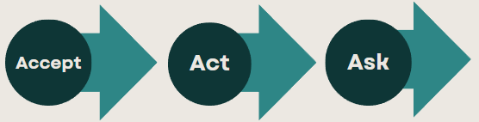
We are learning about headaches and how they effect young people
To help you understand the what you can do about your headaches if they are a problem
To identify causes, symptoms, and effective treatments for headaches.
To provide practical approaches to managing your headache and encourage healthy lifestyle choices.
Get to grips with headache in schools

Slide 3
World ranking for disability under 25 years old (WHO 2019) | Problem
1. | Road injury
2. | Headache disorders
3. | Self-harm
4. | Depressive disorders
5. | Violence
6. | Anxiety
Notes:
You are not alone. 30% of school students have troublesome headache. Headache is number two in terms of health problems in young people in the world.

Slide 4
The spectrum of headache in young people
Headache can be mixed with both types experienced. Both types can be exacerbated by stress or anxiety.
Migraine
One or both sides
Pain more severe, 1 – 72 hours
10% get an aura, usually visual but any neurological symptoms possible
Additional features such as nausea or vomiting, light, sound, movement, touch increased sensitivity
Genetic disposition. invariably a family history of migraine
Tension type headache
Dull, usually both sides
Length variable
No additional features
Notes:
Two types of headache. Can occur out of the blue but often associated with stress. Migraine occurs in over 1 in 10 young people and is the more problematic.

Slide 5

Things that can cause headache.
Erratic food intake, poor diet, lack exercise,
lack hydration. Too much screen time.
Family, relationship problems
Anxiety, low mood
School pressures
Poor sleep
Bullying
Notes:
These are some of the things that can impact on headache including unhealthy lifestyle.

Slide 6
Headache and Wellbeing
Information
The Complex, inter
-
related elements involved in problematic headache.
Migraine has a strong genetic element.
Erratic
food
intake,
Family, relationship
p
oor diet, lack exercise,
problems
l
ack hydratio
n
Anxiety, low mood
School pressures
Poor sleep
Bullying
Genetic predisposition
Get to grips with headache in schools
Notes:
Migraine runs in families. If you have migraine your headache may just come out of the blue but often it is made worse by stress.

Slide 7

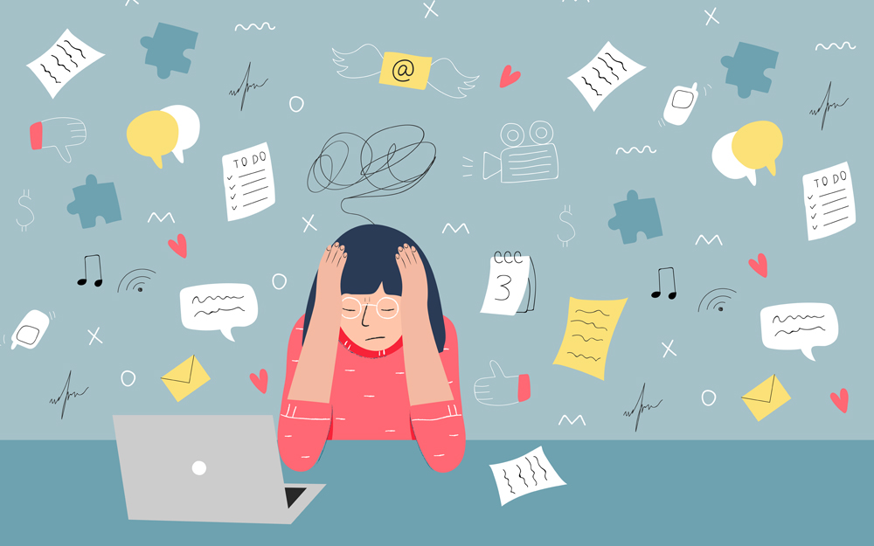


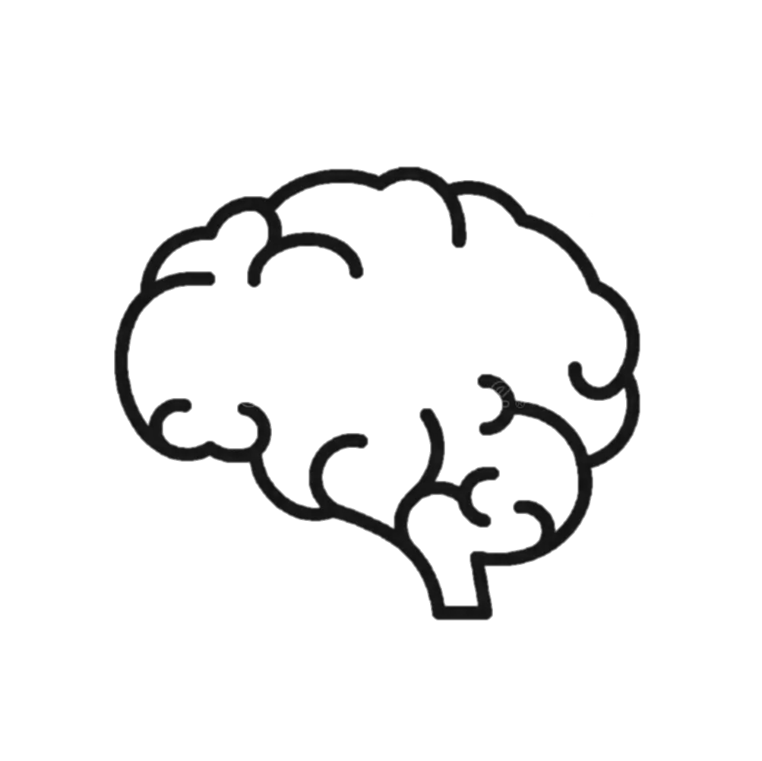

Understanding Stress
Starter
How does stress make you feel?
Stress is the body's response to any demand or challenge. It can be caused by various factors, including schoolwork, relationships, or major life changes. It can make headache worse.
Get to grips with headache in schools
Notes:
Stress can make headache worse. Ask for help if you have worries

Slide 8

Sometimes headache is simply fixed
Head First Aid
Water
Sleep
Exercise (providing doesn’t make headache worse)
Pain Killer (a small dose of paracetamol or ibuprofen)
Limited Screen time
Get to grips with headache in schools

Slide 9
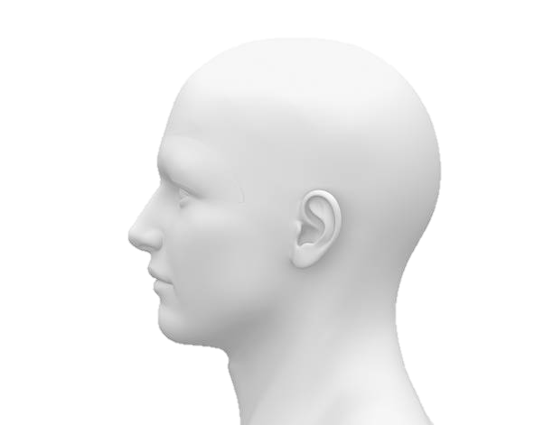
Managing Stress and Preventing Headaches
Managing Stress and Preventing Headaches
1. Healthy Lifestyle Choices
Regular Exercise: Physical activity releases endorphins, which can reduce stress and prevent headaches.
Balanced Diet: Eating nutritious meals at regular intervals keeps energy levels stable and reduces stress.
Adequate Sleep: Ensuring 8-10 hours of sleep helps the body recover and manage stress better.
2. Stress Management Techniques
Relaxation Exercises: Deep breathing, meditation, and yoga can help calm the mind and reduce stress.
Time Management: Prioritizing tasks and breaking them into manageable steps can reduce feelings of being overwhelmed.
Hobbies and Interests: Engaging in activities you enjoy can provide a break from stress and boost your mood.
3. Seeking Help
Talk to Someone: Sharing your feelings with friends, family, or a counsellor can provide support and reduce stress.
Professional Help: If headache or stress are bothering you, seek help from a healthcare professional, such as a psychologist or doctor.
Get to grips with headache in schools
Notes:
These are some of the things you can do to help your headache

Slide 10
When to go to the GP
Information
Your head pain is getting worse
It is impacting on your school or home life
A change is how the head pain ‘acts’
Head pain that seems connected to other things (For example, weakness or memory loss)
If head pain starts suddenly after exercise, coughing or straining
Get to grips with headache in schools

Slide 11

Signposting
Signposting
Home - The Migraine Trust (An organisation for patients run for people with migraine)
https://www.nhs.uk/conditions/headaches/10-headache-triggers/
Get to grips with headache in schools

